Slide 1




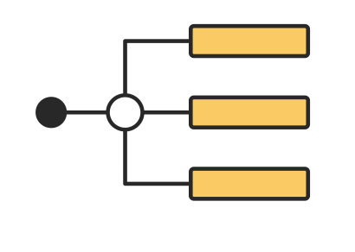
SAT Decision Scraper & Search Application with RAG
Project Client: Josh Tedjasaputra (Customer Experience Insight Pty Ltd)

Slide 2

CONTENTS
01
Introduction
02
Data investigation
03
Front-end
04
RAG
Notes:
DONE

Slide 3

01
Introduction
Notes:
DONE

Slide 4


INTRODUCTION
SAT (State Administrative Tribunal） has published many tribunal decisions and cases over the years.
TARGET USERS：
General : General purpose for everyday seeking information for public user.
Professional : Lawyers, Judgers
CHALLENGES：
Cases and decisions are not easy to search.
Difficult to customize search requirements.
Relevant knowledge base is inadequate.
Notes:
FIXME

Slide 5
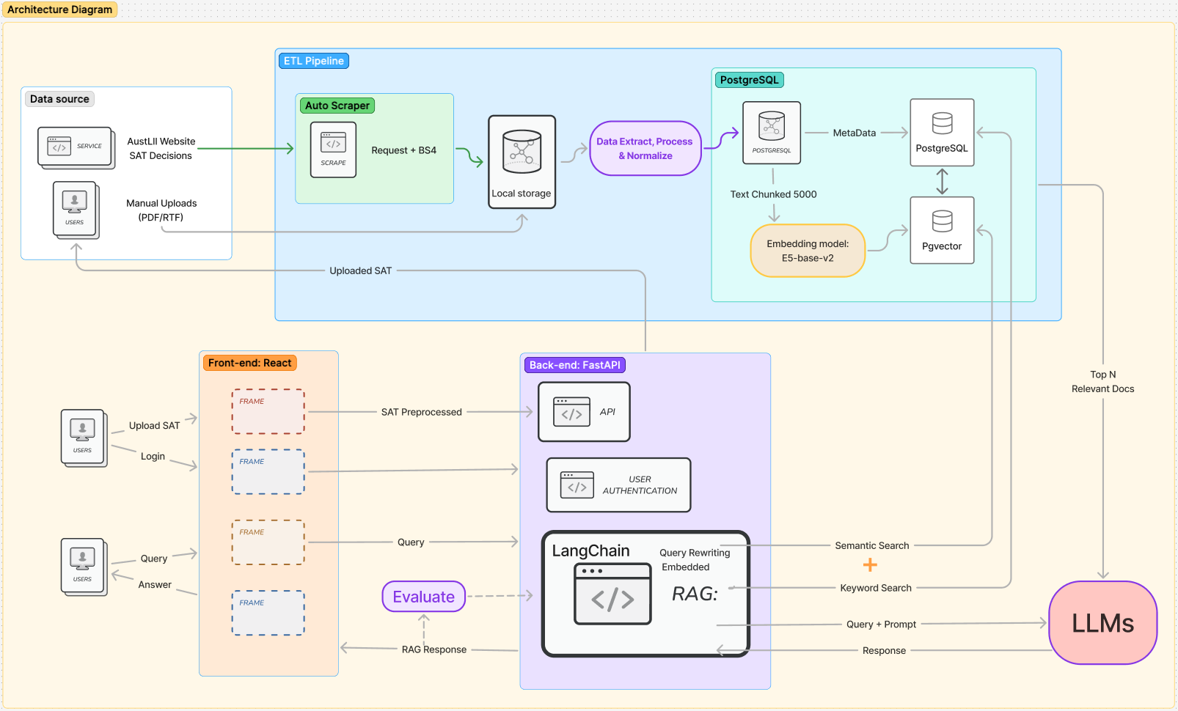
High-level architecture
Project Features
Data source
Database
RAG
Front-end
Notes:
FIXME

Slide 6
02
Data investigation

Slide 7
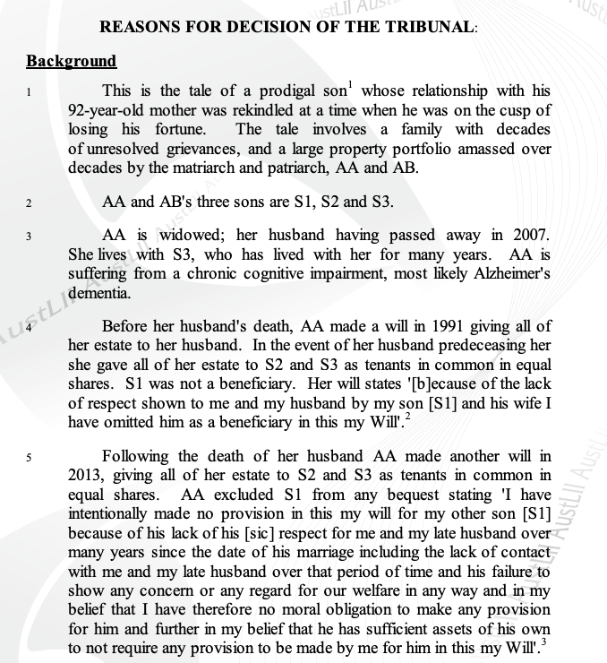
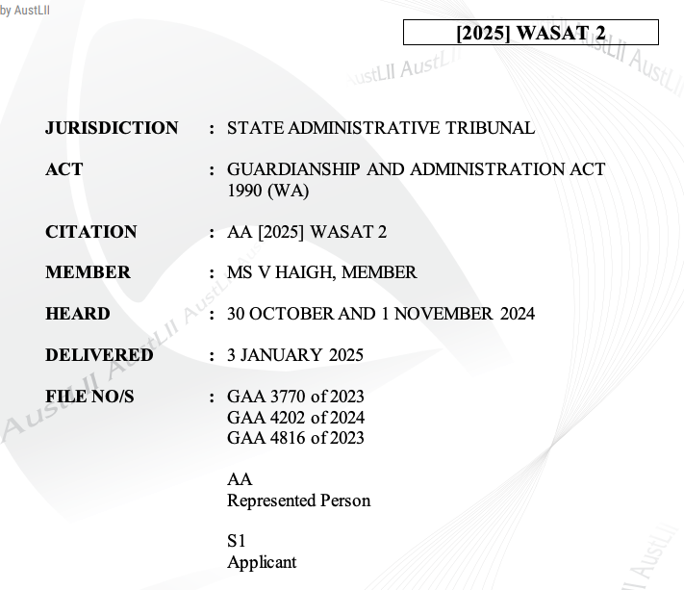
DB design & website demo
Metadata
Text
Notes:
FIXME

Slide 8
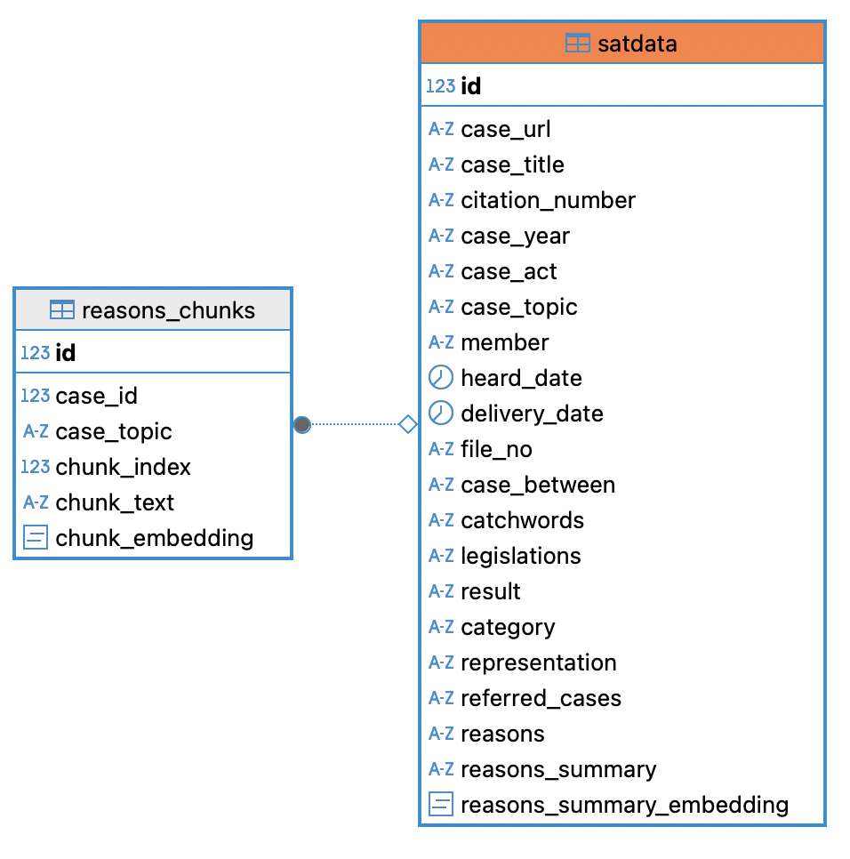
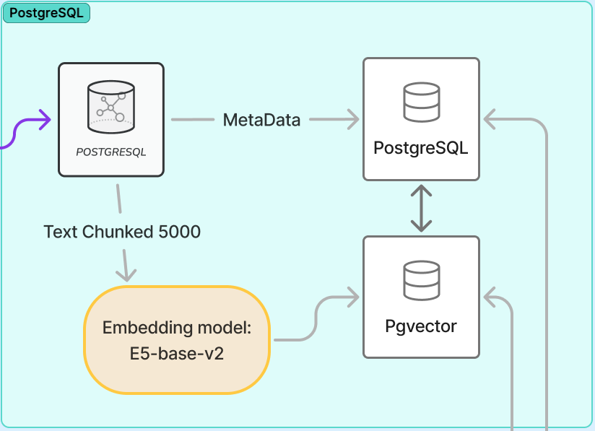
DB design
Notes:
FIXME

Slide 9
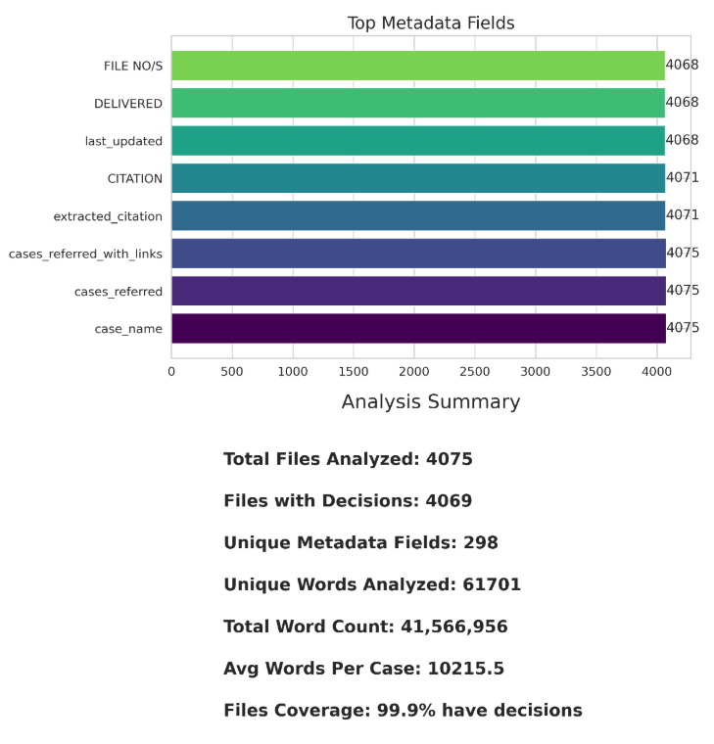
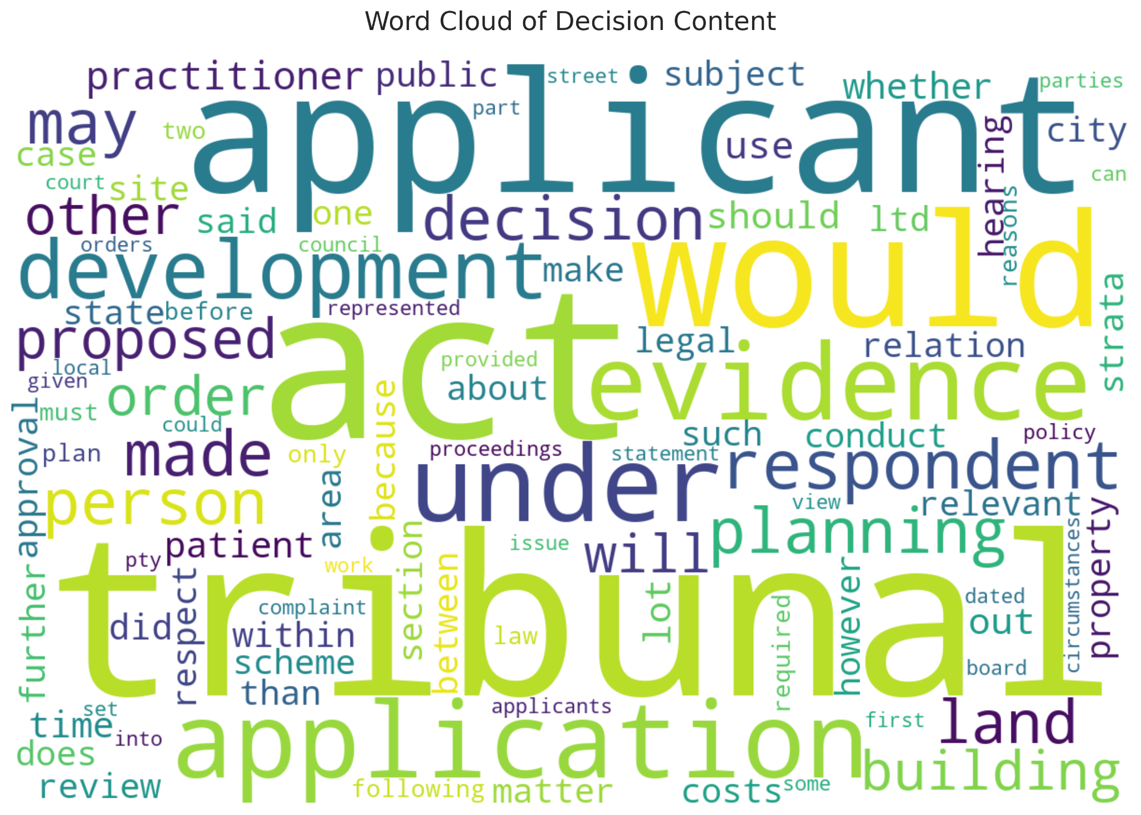
Data investigation
Notes:
FIXME

Slide 10
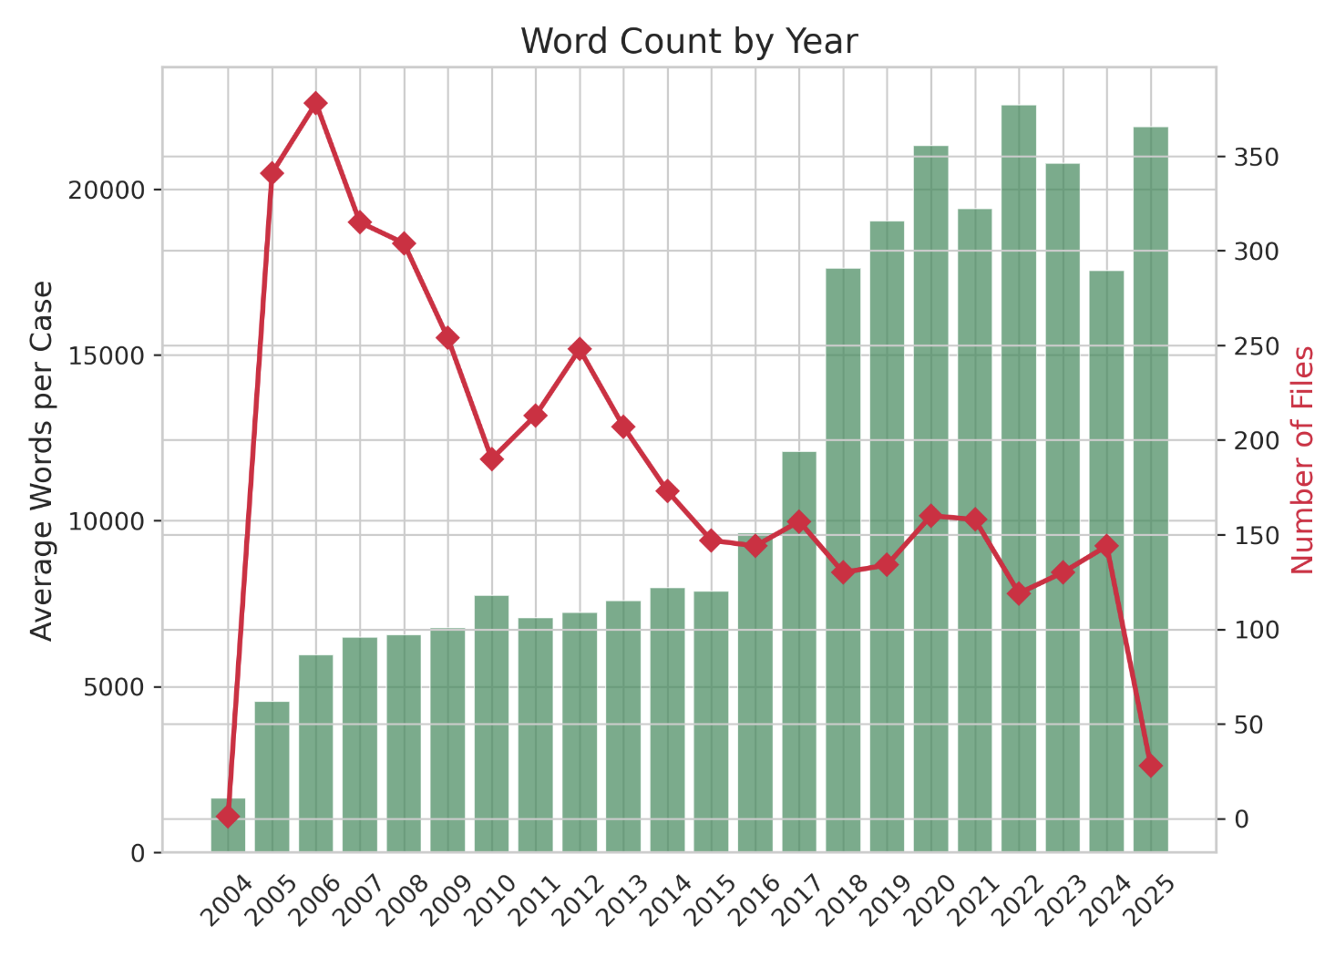
Data investigation
Help lawyers
Chunk size adjustment
Notes:
FIXME

Slide 11


03
R A G

Slide 12
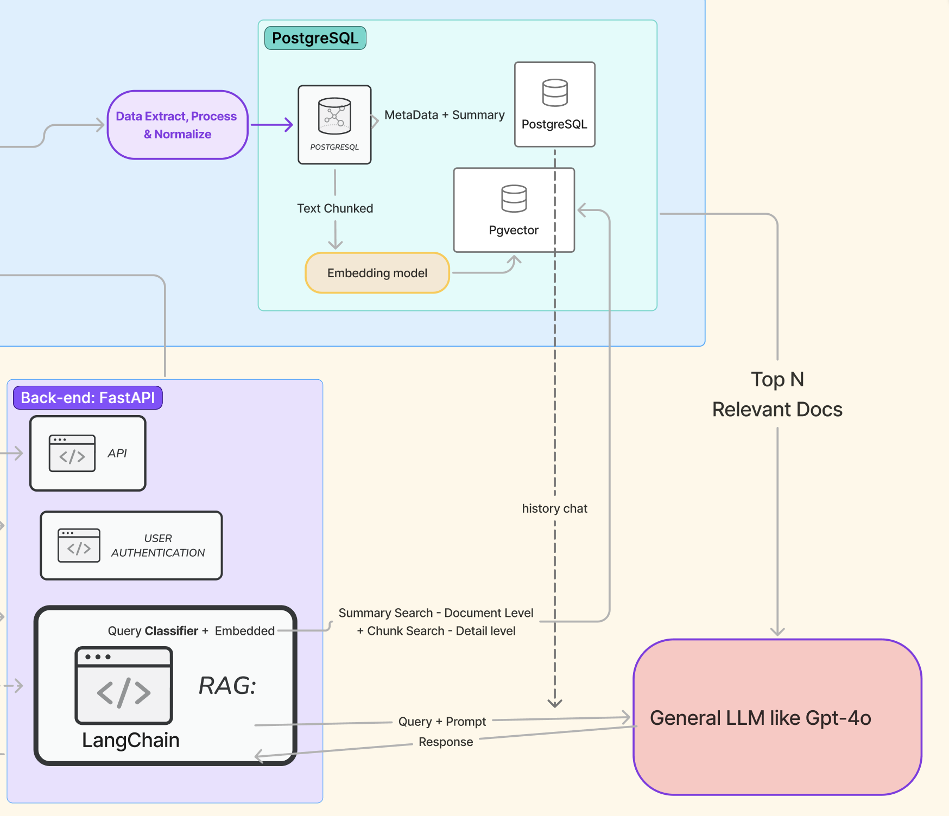
RAG - Chat Service
Database: Postgresql + Pgvector
Chat Query type：
General question
Find similar cases question
Two search level：document + chunk
Notes:
Query-focused design with stateful conversations
Conversations stored in PostgreSQL for history tracking
Real-time streaming support through async callbacks
Direct embedding-based similarity search using e5-base-v2 model

Slide 13
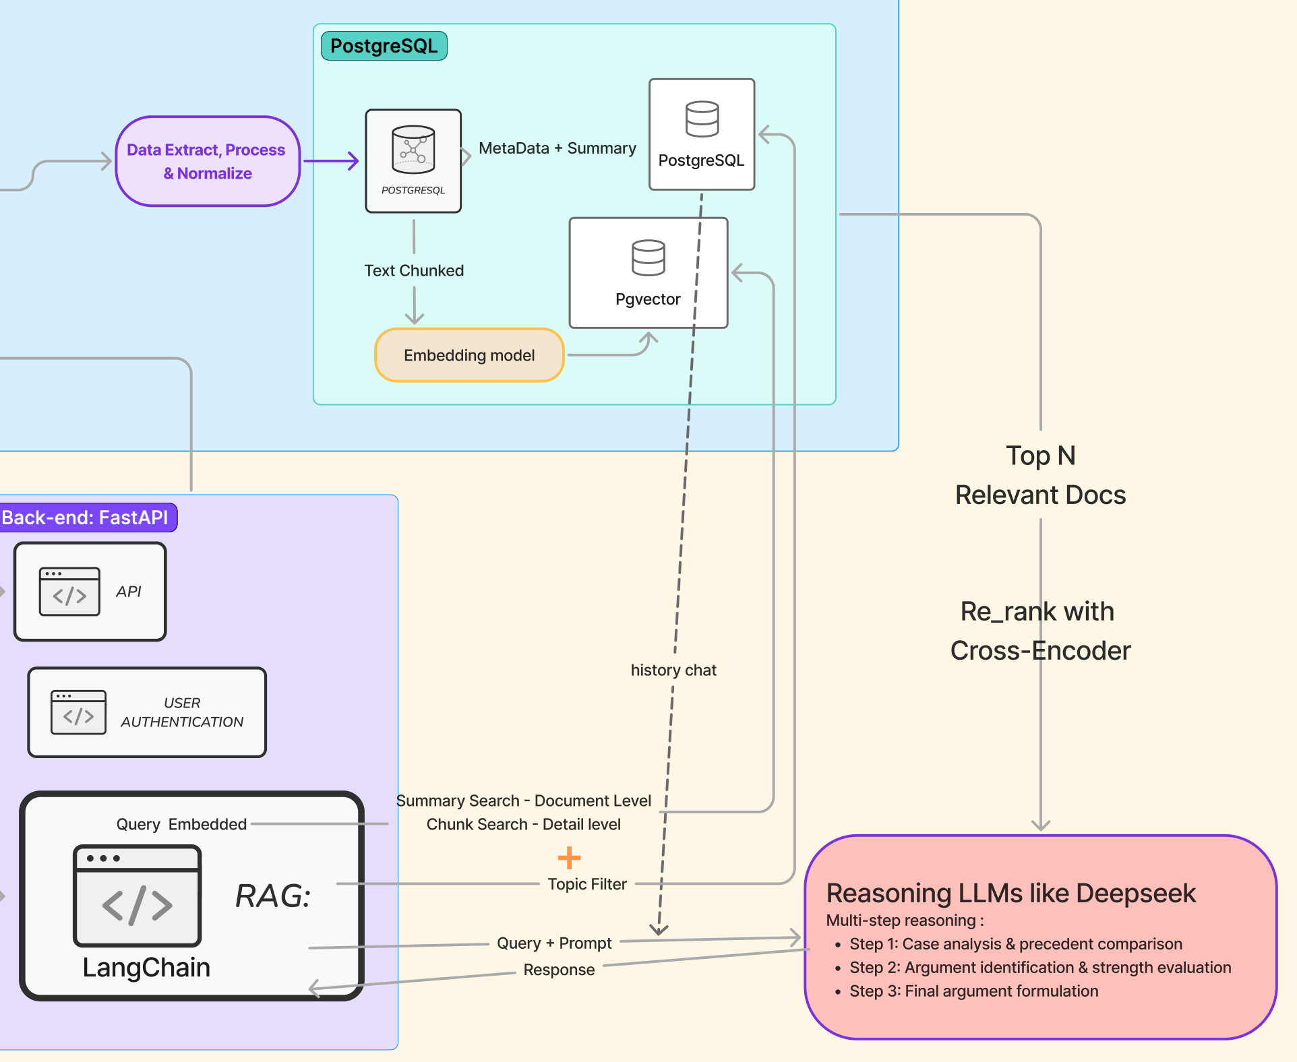
RAG - Build Argument Service
Topic filter based on legislation
Rerank with cross encoder
Reasoning with steps
Notes:
Multi-step reasoning using DeepSeek Reasoner:
Step 1: Case analysis & precedent comparison
Step 2: Argument identification & strength evaluation
Step 3: Final argument formulation
Structured output with insights, arguments, counterarguments
Uses combined document + chunk retrieval for comprehensive context
Claude-3.7-sonnet fallback for reliability

Slide 15
RAG demonstration

Slide 16
Introduction user story
public general question for SAT
lawyers, professional argument to help them work better
Chat function
Argument function —— for lawyer

